Slide 1
Grow Through The Arts
Girl Scout Gold Award Project
By: Erin Brown, Troop 4491

Slide 2
My Story of Growing Through The Arts
My mother put me in ballet when I was three years old because I enjoyed moving to music
I continued in dance because I truly enjoy dancing, found a circle of friends, enjoyed performing, and challenged myself to improve everyday
As I’ve been dancing continuously through High School, I realized that I’ve learned important skills and gained incredible support through the Performing Arts such as:
Time management and focus with school while balancing a significant commitment to dance
Being able to express myself – having my dance studio as a safe space
Gaining confidence through continued improvement and performance opportunities
Having role models and becoming one myself
Having an amazing support system of friends and family

Slide 3
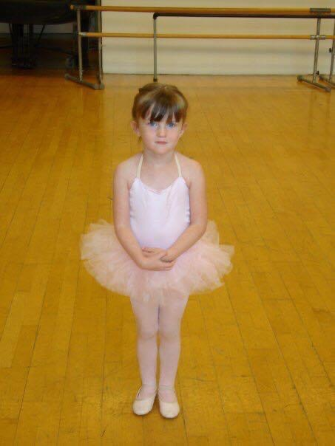
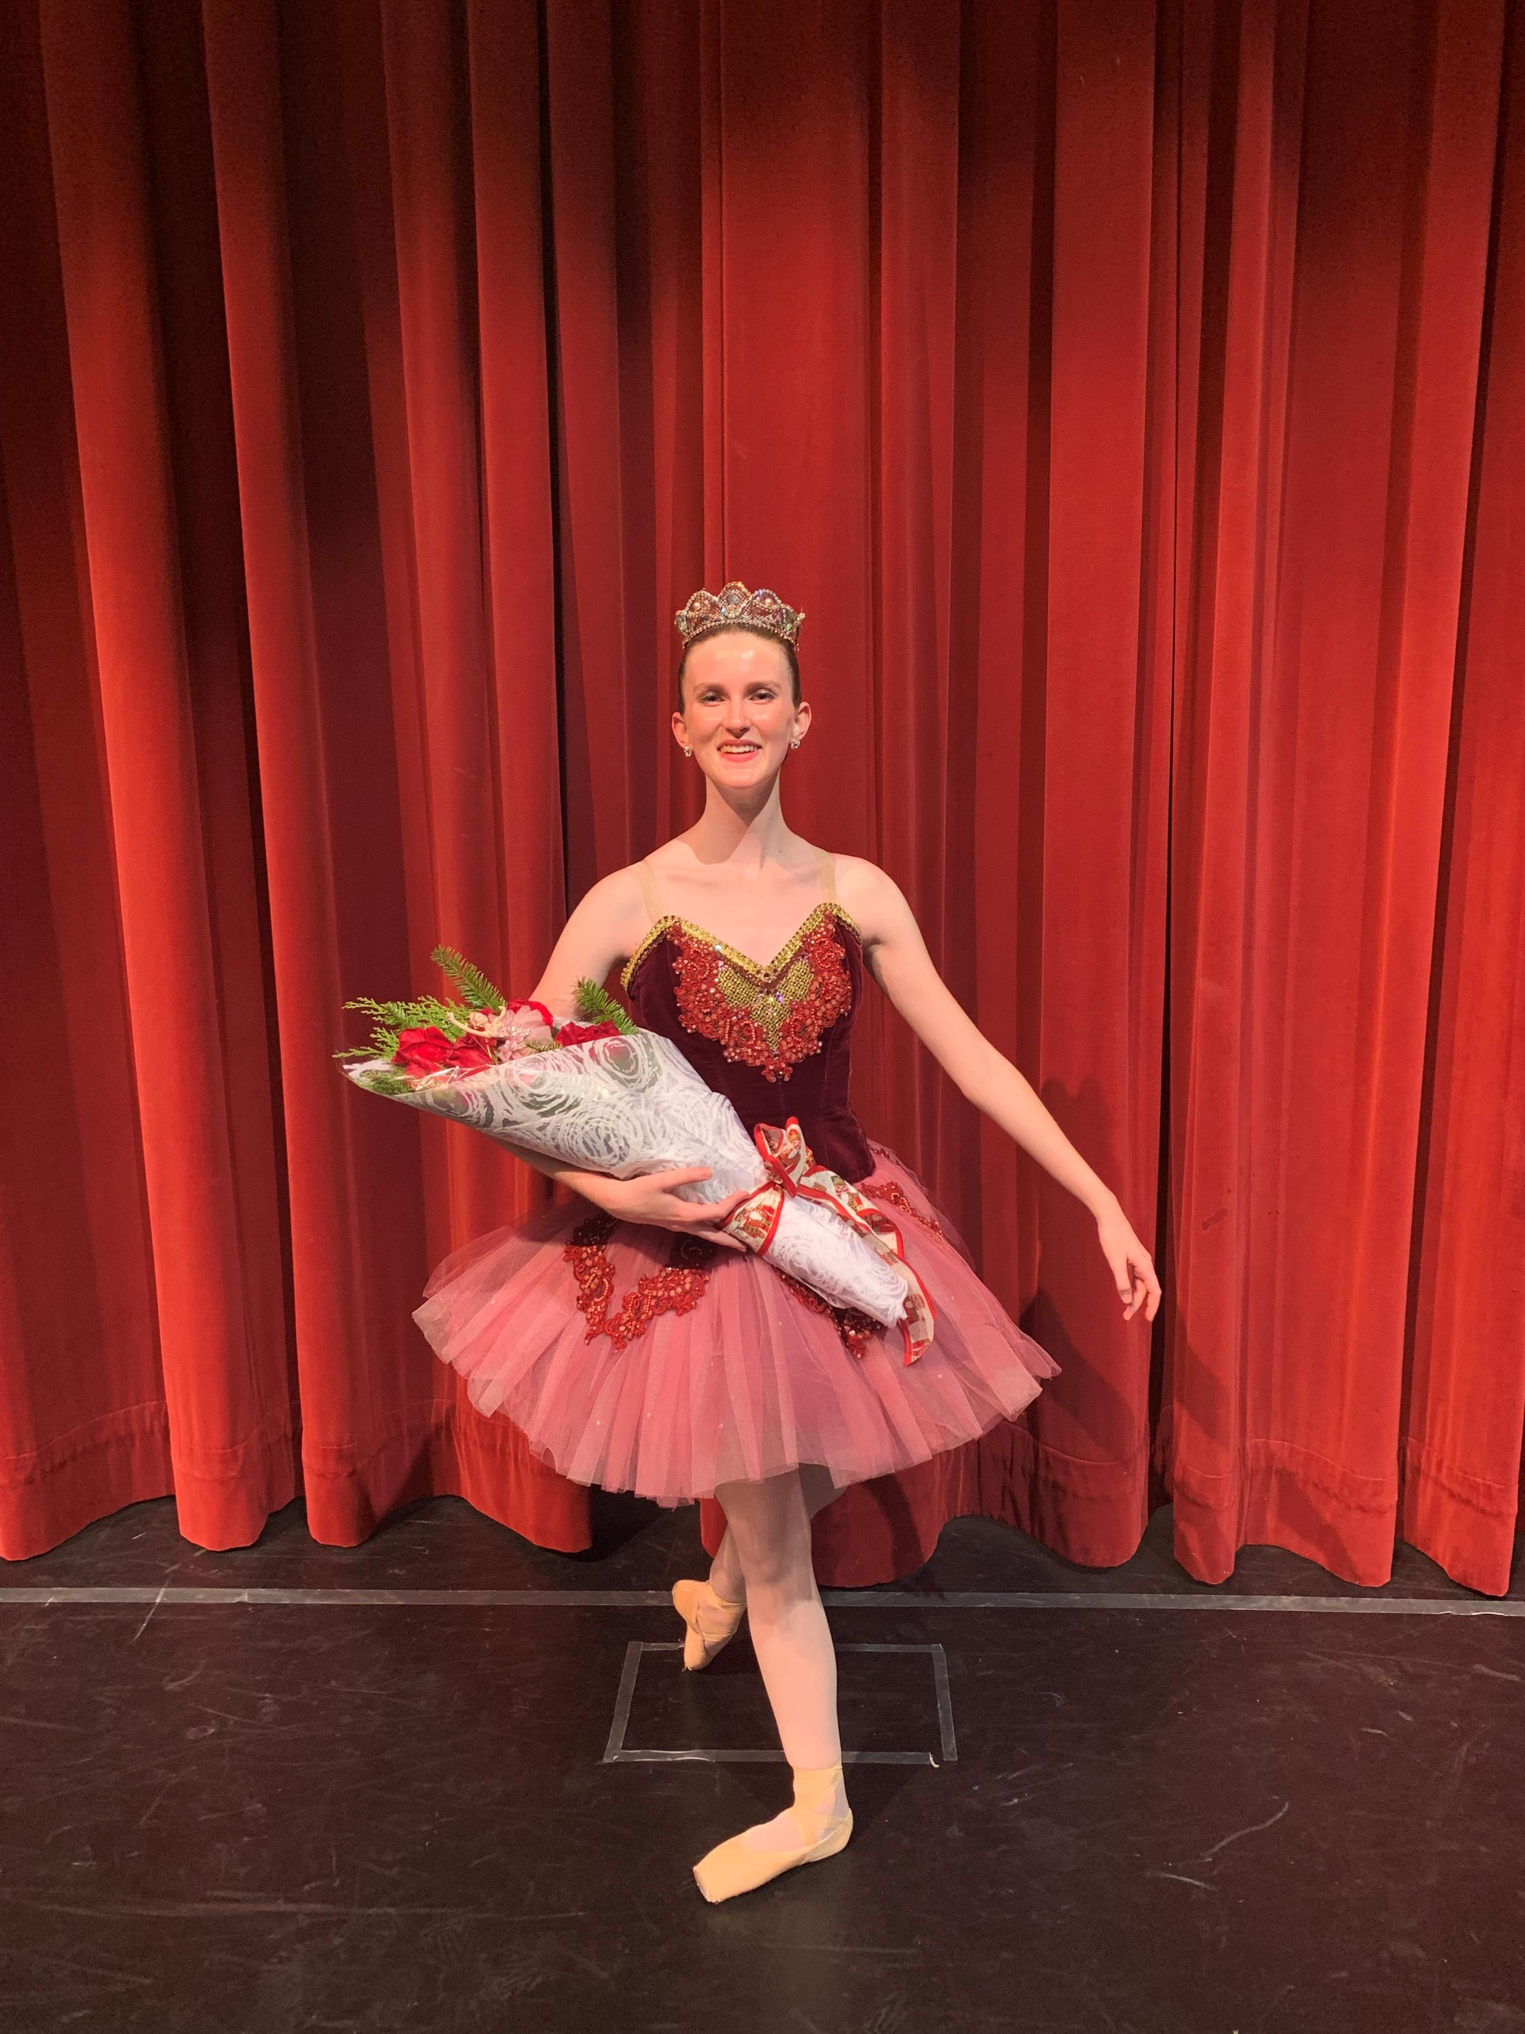
My Story (Continued)
Last summer, I auditioned and was accepted into Ballet West’s summer intensive program and spent five weeks in Utah dancing for 6 days a week for 5-6 hours a day
This summer I will travel to Boston for Boston Ballet’s five-week summer intensive
The experiences I have gained from my commitment to ballet are one of a kind and they have shaped who I am as a dancer and person
I chose this topic for my Girl Scout Gold Award project because I want others to experience, even just a little bit, of the benefits I have received from my participation in the Performing Arts!

Slide 4
Lack of Awareness
The lack of awareness of the many different benefits the Performing Arts can offer children as they develop is the root issue I am addressing.
“Over the last few decades, the proportion of students receiving arts education has shrunk drastically. This trend is primarily attributable to the expansion of standardized-test-based accountability, which has pressured schools to focus resources on tested subjects. As the saying goes, what gets measured gets done.” - https://www.brookings.edu/blog/brown-center-chalkboard/2019/02/12/new-evidence-of-the-benefits-of-arts-education/
“Despite increasing evidence published in top, peer-reviewed journals, on the measurable benefits of the arts in education, such as increased academic performance and the development of innovative thinking, the arts continue to be marginalized in education.” - https://world.edu/brain-research-shows-the-arts-promote-mental-health/#:~:text=Despite%20increasing%20evidence%20published%20in%20top%2C%20peer-reviewed%20journals%2C,the%20arts%20continue%20to%20be%20marginalized%20in%20education.
As a result of the lack of Performing Arts in many schools, parents may not recognize the importance of seeking outside opportunities in the Performing Arts for their children.

Slide 5
Main Areas of Benefit
Physical
Mental
Emotional
“The world is a complicated place, and there's a lot of division between people. The performing arts tend to unify people in a way nothing else does.” - David Rubenstein, businessman and chairman of the Kennedy Center for the Performing Arts

Slide 6
Physical Benefits
The improvement of fine and gross motor skills and overall physical fitness comes with dancing consistently.
“The Arts develop children’s motor skills: This is essential for many activities including writing letters and words. Playing an instrument, using a paint brush or shaping modelling clay develop gross and fine motor dexterity and control (Fox, 2008).” - https://ecc.gov.jm/benefits-of-the-arts-in-early-childhood-development/
The many physical benefits from dance are more known than the many other benefits:
weight management
increased aerobic fitness
improved muscle tone and strength
improved condition of heart and lungs
increased muscular strength, endurance, and motor fitness
stronger bones and reduced risk of osteoporosis
better coordination, agility, and flexibility
improved balance and spatial awareness
https://www.betterhealth.vic.gov.au/health/healthyliving/dance-health-benefits#health-benefits-of-dancing

Slide 7
Physical Benefits (Continued)
Dance has also proved to be extremely helpful for coordination.
“New research published in the Journal of Neurophysiology reports that professional ballet dancers’ years of physical training have enabled their nervous systems to coordinate their muscles when they move more precisely than individuals who have no dance training. According to the researchers, the results show that years of ballet training changed how the nervous system coordinated muscles for walking and balancing behaviors.” - https://neuro.gatech.edu/study-finds-ballet-training-may-improve-balance-and-coordination-daily-activities#:~:text=New%20research%20published%20in%20the%20Journal%20of%20Neurophysiology,precisely%20than%20individuals%20who%20have%20no%20dance%20training.
“Football Hall of Famers, Lynn Swann and Herschel Walker, both famously took ballet classes decades ago. More recently, New England Patriots’ tight end, Rob Gronkowski, was filmed taking a ballet lesson, while the Dallas Cowboys installed ballet bars outside the locker room to motivate players to stretch in a different way.” - https://www.sikids.com/from-the-mag/twinkle-toes-nfl#:~:text=Hall%20of%20Famers%20Lynn%20Swann%20and%20Herschel%20Walker,motivate%20players%20to%20stretch%20in%20a%20different%20way

Slide 8
Mental Benefits
The Performing Arts improve cognition which is the mental action or process of acquiring knowledge and understanding through thought, experience, and the senses.
“Pediatrician Dr. Perri Klass outlined the benefits of art education in schools in the New York Times, noting improvements for overall motivation, thinking, and academic achievement.” - https://arteducationmasters.arts.ufl.edu/articles/importance-of-art-education/
“Music can accelerate brain development. The areas of language acquisition and reading skills benefit tremendously. Learning to play an instrument has been found to improve mathematical learning, boost memory and even lead to better academic test scores (Bright Horizons, 2017).” - https://ecc.gov.jm/benefits-of-the-arts-in-early-childhood-development/
The Performing Arts help to develop a growth mindset, which is the belief that skills and intelligence can be improved with effort and persistence.
“Most children, no matter how casually they pursue a particular artistic medium, develop a growth mindset by flexing their creative muscles.” - https://www.cdm.org/blog/arts-and-the-growth-mindset/
“The Arts build the creative side of the brain. The Waldorf Education system is grounded in the understanding of the connection between the arts and brain development. In this system of education, there is full infusion of the arts in the teaching and learning experience. Waldorf Education asserts that children learn through play, music and art, and that this approach creates multidimensional individuals who are creative and innovative.” - https://ecc.gov.jm/benefits-of-the-arts-in-early-childhood-development/

Slide 9
Mental Benefits (Continued)
The Performing Arts increase focus and perseverance.
“Performing arts teaches children perseverance, creative problem-solving, and the ability to focus - all great skills that will lead to classroom success … embodying another person’s story through acting, voice, dance, and music allows children to walk a mile in someone else’s shoes.” - https://performingartsworkshops.com/5-benefits-of-a-performing-arts-education/#:~:text=Performing%20arts%20teaches%20children%20perseverance%2C%20creative%20problem-solving%2C%20and,to%20walk%20a%20mile%20in%20someone%20else%E2%80%99s%20shoes.
Another benefit of the Performing Arts is increased self-awareness.
“By the third and fourth lessons, … the student was transformed: She carries herself differently; she speaks differently; she is kind; she is respectful; she has not had one [disciplinary notice], not one. Her mother can't believe what she sees. It's amazing. Amazing. The program is far greater than people understand.” - Why is Dance Just as Important as Math in School by Sir Ken Robinson and Lou Aronica

Slide 10
Emotional Benefits
The Performing Arts can greatly improve self-confidence.
“The Arts build children’s self-esteem by giving them the autonomy to express themselves. As a group activity, children working together provides them the opportunity to give each other feedback, which aids in learning how to receive criticism and praise from others (Fox, 2008).” - https://ecc.gov.jm/benefits-of-the-arts-in-early-childhood-development/
Compassion through communication/building trust can be enhanced through the Performing Arts.
“The connection between Music and the Performing Arts and teaching compassion is intrinsic. During the most strenuous and challenging of times, the arts are what keep us grounded and connected. They are a powerful means of helping us feel, relate, and understand more deeply. Compassion is about empathizing and thoughtfully considering the experiences, struggles, and challenges those around us face.” - https://www.butlerschool.org/blog/compassionmusic
“First, Music is a shared language and means of expression; it erases barriers and divisions, bringing unity and inspiring love. Second, music teaches collaboration and generosity; it challenges students to be compassionate by helping their peers achieve their fullest potential. Third, music teaches patience and compassion in the act of learning itself—students are encouraged to take every new exercise and project with grace and courtesy.” - https://www.butlerschool.org/blog/compassionmusic

Slide 11
Emotional Benefits (Continued)
The Performing Arts is a healthy emotional outlet.
“Arts education helps to reduce stress among the economically disadvantaged says a study on the inclusion of music, dance and visual arts lessons among 310 preschoolers from poor backgrounds (Society for Research in Child Development, 2016). Knowing that poverty leads to stress and that stress is a contributor to poor health, the benefits of arts education may perhaps be greatest among the economically disadvantaged.” - https://ecc.gov.jm/benefits-of-the-arts-in-early-childhood-development/
“Dance can help restore joy and stability in troubled lives and ease the tensions in schools that are disrupted by violence and bullying.” – Why is Dance Just as Important as Math in School by Sir Ken Robinson and Lou Aronica

Slide 12
Summary Statements
“The incorporation of the Arts in early childhood has many benefits, and children’s involvement in Arts-infused programs and activities will develop their cognitive, creative, social and emotional skills, playing a large part in their optimal development.” - https://ecc.gov.jm/benefits-of-the-arts-in-early-childhood-development/
“The studies collected by Nielsen and Burridge Editor (Professor and college lecturer, respectively) explore how a deeper understanding of dance challenges standard conceptions of intelligence and achievement and show the transformative power of movement for people of all ages and backgrounds.” - Why is Dance Just as Important as Math in School by Sir Ken Robinson and Lou Aronica
“Anyone who’s passionate about the Arts recalls formative moments of experiencing a work of art pushing through a creative challenge. When we’re exposed to remarkable artworks or have opportunities to create, we find that art is crucial to individual growth and development and can even impact our health.” - https://arteducationmasters.arts.ufl.edu/articles/importance-of-art-education/

Slide 13
Testimonial Video
As a part of my research, I asked a group of my peers that are involved in dance, musical theater, art, and music about how the Performing Arts has impacted their lives. Recurring themes of what they have learned or experienced through the Performing Arts include:
Respect
Responsibility
Discipline
Hard work
Dedication
Creativity
Gratitude
Teamwork
Stability
Safe/Home
Commitment
Time management
Practice
Improvement
Expression
Joy
Comfort
Healthy outlet
Physical/Mental well-being
Community
Passion
Escape
Alive
Confidence
Identity
Security
See attached video of the testimonials and performance clips of my peers.

Slide 14
Ways to Get Involved in the Arts (Examples in San Diego, California)
School offered choices/Clubs: Look into the Arts provided at your local schools and support the inclusion of the Performing Arts in the curriculum available to every child. There may be elective classes that will offer children the opportunity to be exposed to the Arts. There may also be clubs such as dance, drama, music and art at school that can support children in their journey with the Arts!
Examples of traditional public and magnet schools: https://www.sanpasqualunion.net/Page/2299, San Diego School of Creative & Performing Arts | San Diego Unified School District, Home - Creative Performing Media Arts (CPMA) Middle (sandiegounified.org)
After school programs: If there are not many options at school, after-school programs may be available on school campuses or through organizations, such as the YMCA and the Boys & Girls Club.
Examples: https://www.ymcasd.org/program-finder, https://dancetoevolve.com/san-diego/after-school-programs/
Classes/camps offered through local cities: Certain cities may offer classes, which could be a low cost alternative.
Examples: https://recreation.escondido.org/register-for-a-class, https://civicdancearts.org/
Private organizations: There are many well-rounded organizations that are great options for those that are interested in pursuing dance, music, theater, and art.
Example for Dance/Musical Theater: https://www.scrippsperformingartsca.com/ (offers free introductory classes), https://www.cytsandiego.org/ (musical theater)

Slide 15
Conclusion
I appreciate your time spent learning about the many benefits the Performing Arts can have on children
The physical, mental, and emotional benefits immensely change children's lives for the better
When deciding what activities children will participate in, keep in mind all the ways the Performing Arts can have a positive impact in all aspects of life
Be an advocate for the Performing Arts in schools and extracurricular activities
Thank you!

